Slide 1




HCMUT & SKKU
Project | 2023
Hair
Heist
Presentation by
Eat Pho with Kimchi
Team 1
박지환 (Park Jihwan)
김동한 (Kim Donghan)
Lisa (Thu Nguyen Quoc Minh)
Travis (Huu Nghia)

Slide 2
HCMUT & SKKU
Project | 2023
ROLES
Frontend
Backend
Kim Donghan
Lisa
Frontend
REST API
Park Jihwan
Travis
Prototyping
REST API
Presentation by
Eat Pho with Kimchi

Slide 3

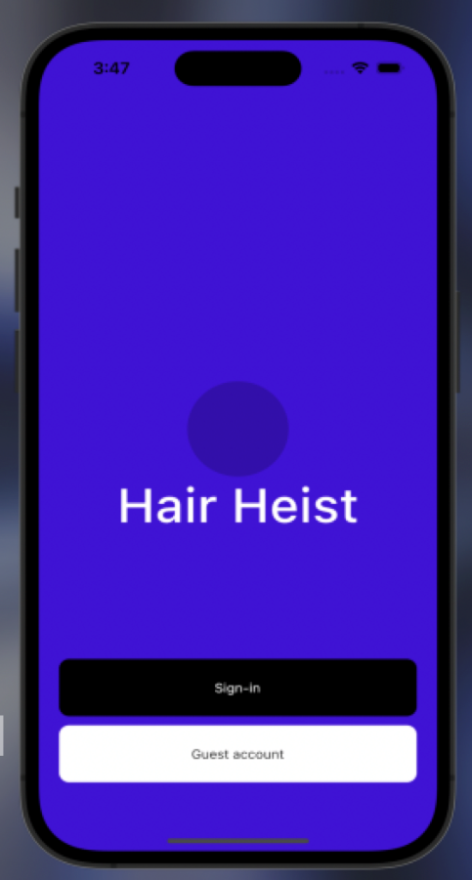





Presentation by
Eat Pho with Kimchi
Contents
Service Introduction
Frontend
Demonstration
Backend
Project | 2023

Slide 4
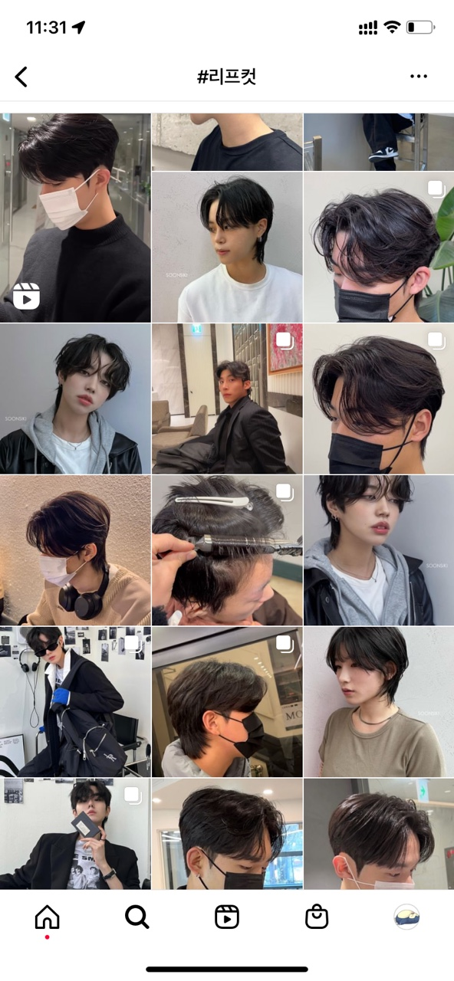
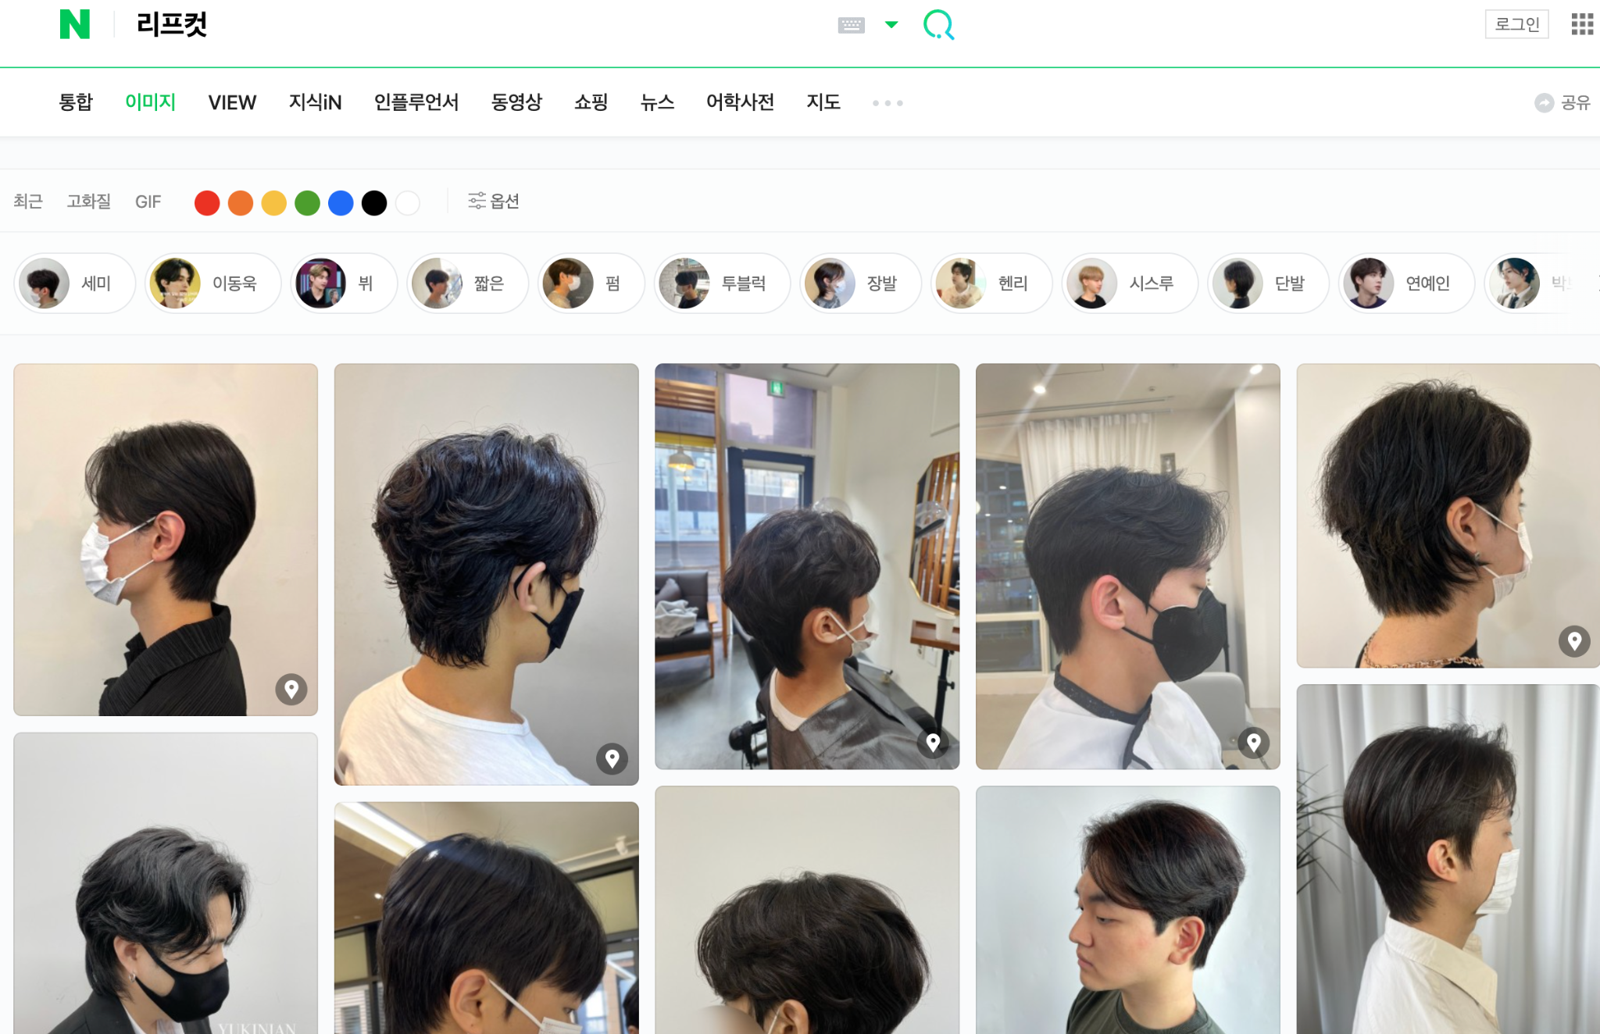
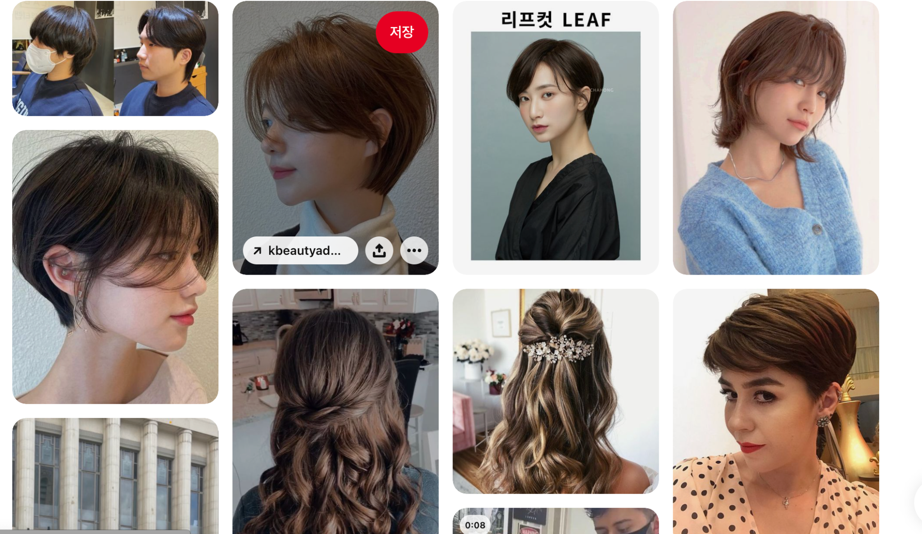
Service Introduction
Eat Pho with Kimchi
Presentation by
Distributed Hairstyle References

Slide 5


Service Introduction
Solution: Hair Heist (Hairstyles Sharing Platform)

Slide 6

Service Introduction
Tech Stack

Slide 7
HCMUT & SKKU
Project | 2023
Demonstration
Presentation by
Eat Pho with Kimchi

Slide 8
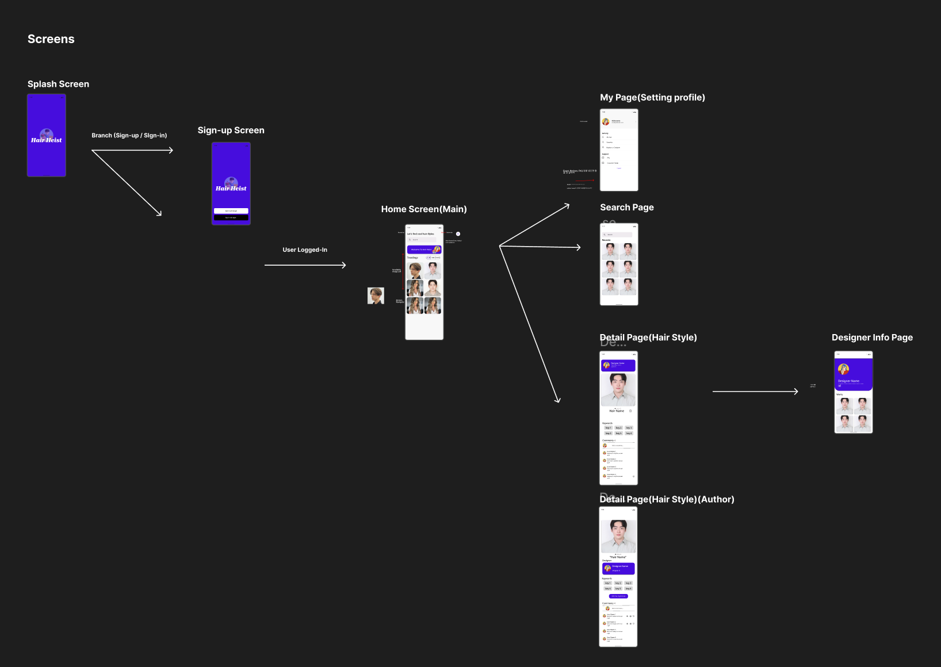

Frontend
Eat Pho with Kimchi
Presentation by
Prototyping

Slide 9
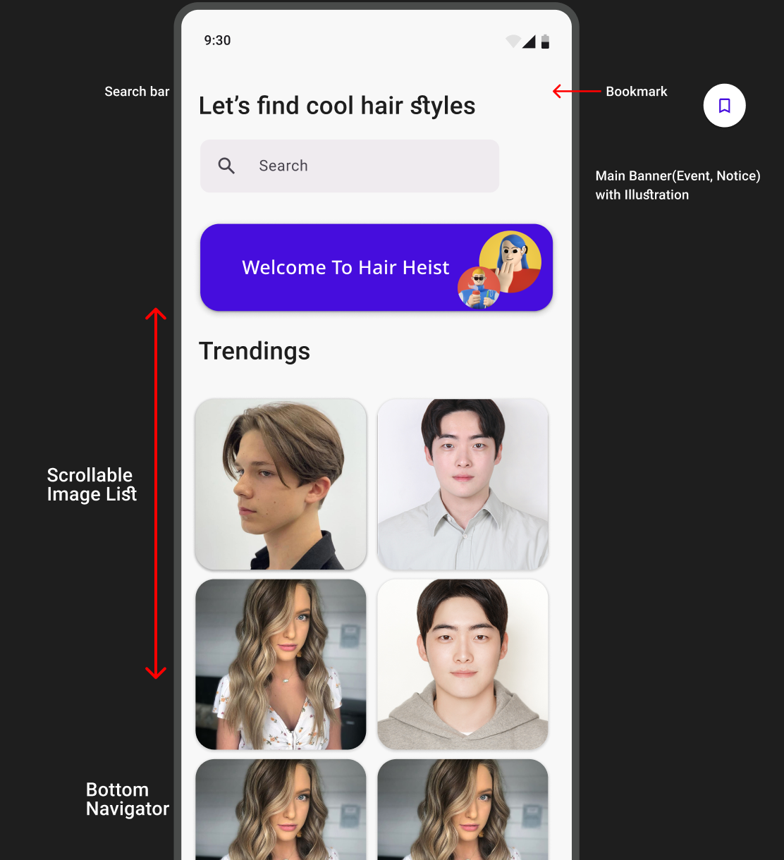
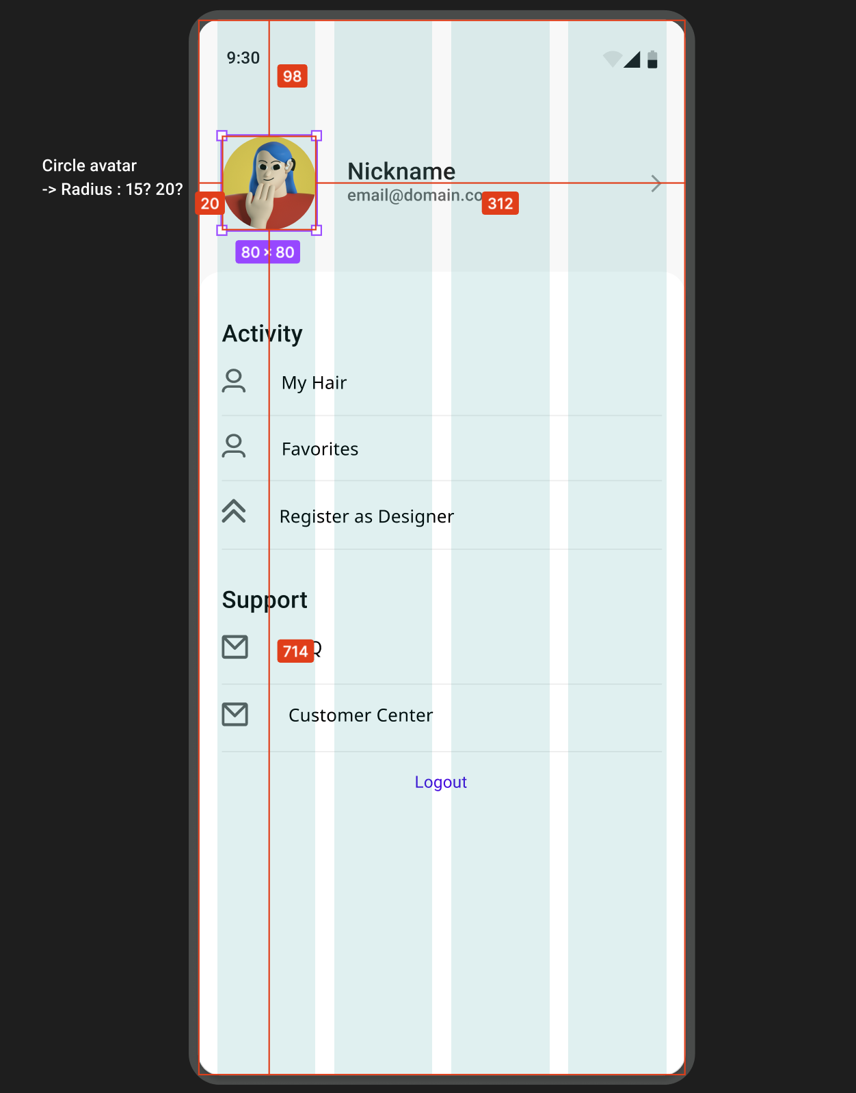
Front end
Eat Pho with Kimchi
Presentation by

Slide 10


Presentation by
Eat Pho with Kimchi
Frontend
Dart
Flutter Framework
Project | 2023

Slide 11
Presentation by
Eat Pho with Kimchi
Backend
Relational Database Design
Feature
Case Tools
Project | 2023

Slide 12

Relational Database Design
We choose Relational Database to represent data and allows easy access to related
data points.

Slide 13
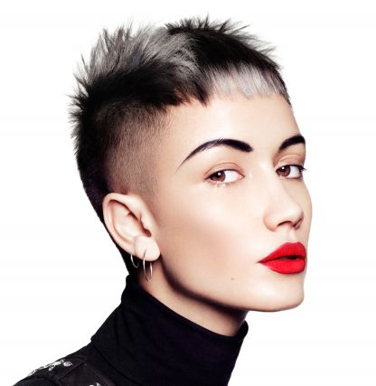
Objectives
Entity | Description
Normal User | For those user who aren’t hair designers, just have demand for finding suitable hairstyle and designer for themselves.
Designer | User who is the hair designer. This user can upload images, and introduction about themselves
Hairstyle | Hairstyles that be uploaded by the designer.
Bookmark | A list of Hair styles that interest normal user.
Comment | Comments of all user in for a specific hairstyle.
Images | Each hairstyle has 1-4 images to describe it. In relational database, just storing the links of images. The source would be store in the cloud.
Eat Pho with Kimchi
Presentation by

Slide 14
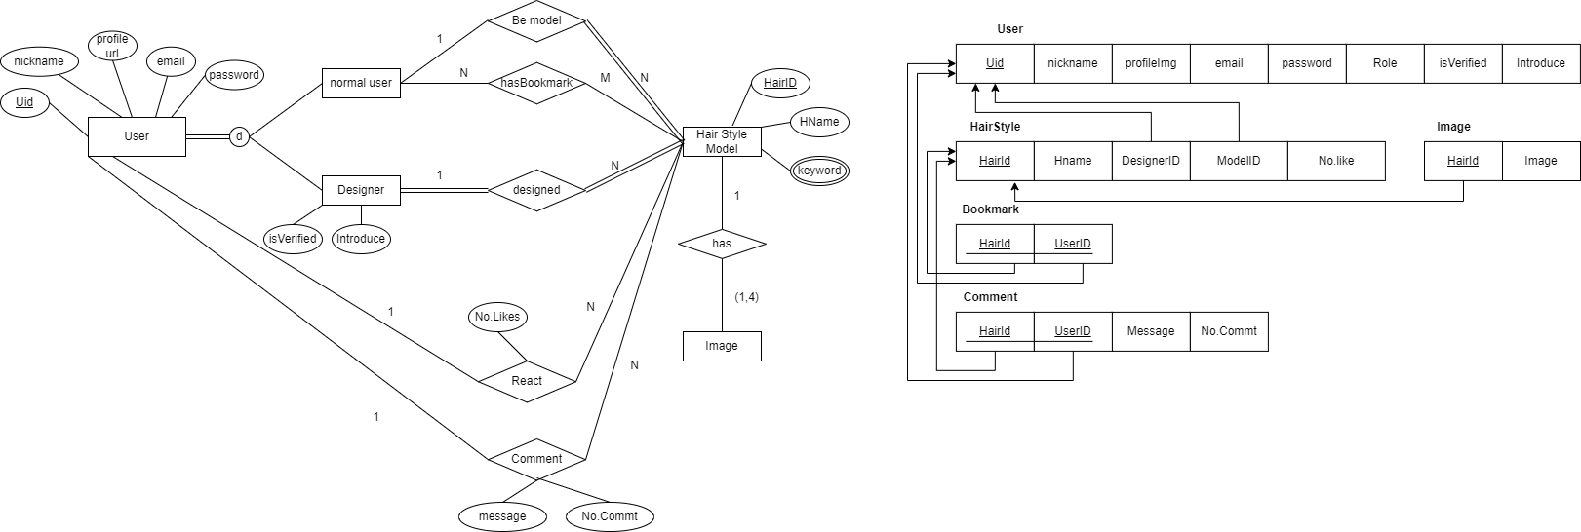
EERD & Relational Mapping
Presentation by
Eat Pho with Kimchi
This system is designed with so much love, and with the intention to make finding the perfect hairdresser easy for clients, no matter where they are
Project | 2023

Slide 15
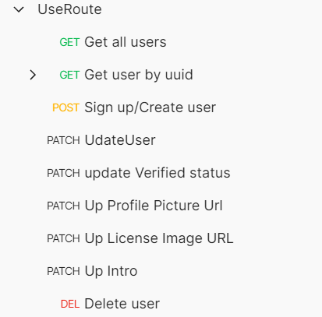
User Model
For Authentication
Method
Eat Pho with Kimchi
String email : email for sign-in
String password : password for sign-in
String uid (unique, primary key) → uuid.v4
String nickName : user's nickname
String profileImgUrl: Link Url Profile picture
String[] bookmarks: List favorite hairStyle of user.
Project | 2023
Presentation by

Slide 16
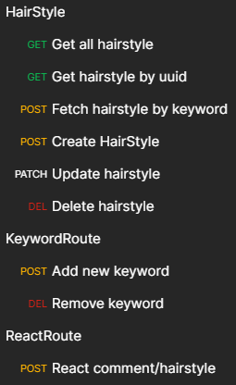
HairStyle Model
Attributes
Method
Eat Pho with Kimchi
String hairId (primary key): → uuid.v4
String designerUid (foreign key): the creator's id
String name : hairstyle's name
string[] keywords :for searching, classification
string[] array of hair style image urls ( 1 - 4 images )
→ for community features
Number of reaction : like or dislike
String[] comments : array for comment ids
Project | 2023
Presentation by

Slide 17







CASE TOOLS
Presentation by
Eat Pho with Kimchi
FROM HAIRHEIST WITH LOVE
Project | 2023

Slide 18
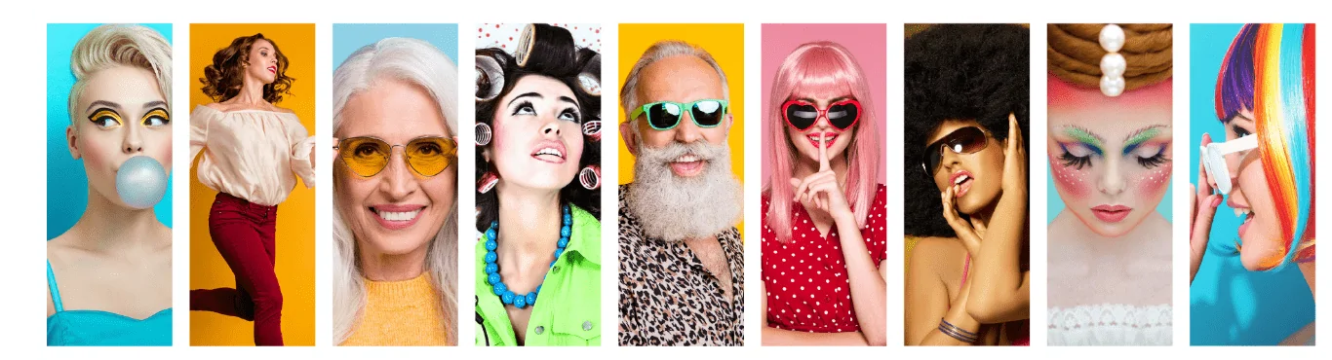
Presentation by
Eat Pho with Kimchi
Messages
This system is designed with so much love, and with the intention to make finding the perfect hairdresser easy for clients, no matter where they are
Project | 2023

Slide 19
HCMUT & SKKU
Thank
You!
Presentation by
Eat Pho With Kimchi
Project | 2023

